Slide 1
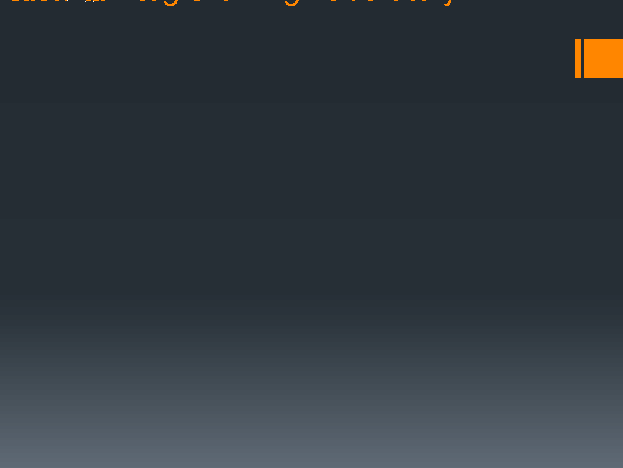

JavaScript(Unit 1)
JavaScript
Modules
Export & Import
const
let
var
arrow functions
Classes
Properties
Methods
Spread & Rest Operator
Destructuring
Array functions
Outcome:
Understand advanced javascript concepts

Slide 2
JavaScript
JavaScript is a dynamic computer programming language. It is lightweight and most commonly used as a part of web pages, whose implementations allow client-side script to interact with the user and make dynamic pages. It is an interpreted programming language with object-oriented capabilities.
Client-side JavaScript
Client-side JavaScript is the most common form of the language. The script should be included in or referenced by an HTML document for the code to be interpreted by the browser.
It means that a web page need not be a static HTML, but can include programs that interact with the user, control the browser, and dynamically create HTML content.

Slide 3
How to use Java Script
-It is available in your browser
-node
Use editor for the same(VS Code)
-Code runner must be installed from extensions(VS Code)
-Live Server must be installed from extensions(VS Code)
Or
jsbin.com

Slide 4
JavaScript Comments
Single line comments
// Change heading:
Multi Line Comments
/*Hi Welcome
To your first class */

Slide 5
JavaScript Variables
Variables used to store data
We can use variable by using
let (introduced in ES6 2015)
Const
Var (for mostly older browsers)
Using nothing
e.g.
const a = 10;
const b = 10;
let c = a + b;
e.g.
Var a=20
let a=25
Const a=30
a=40

Slide 6
JavaScript Variables
If you will declare a variable with var it will keep the previous value(if no value is given now)
e.g. var a=‘apple’
var a;
But the above statement is not valid with let and const
We can directly add number or strings in variable
e.g. let a=2+3+5 or let b= “abc” + ” “ + ”def”
What will be the output of let a =5 +5+’3’ and let a=‘5’+5+3?

Slide 7
JavaScript Variables
let have block scope
{ let x=10}
X can not be used outside that block
But the above thing is not valid for var
We can initialize variable first and can declare later on in case of var (is called hoisting)
ab=10
var ab
We can not initialize variable first and can declare later on in case of let
ab=10
let ab (will give error)

Slide 8
JavaScript Variables
const have block scope
{ const x=10}
X can not be used outside that block
const can not be reassigned
const can not be redeclared
Use const where you know your value is not going to be change
e.g. with Array, with object, with function, with regexp
const defines a constant reference to a value
You can change the values of const array and properties of const object

Slide 9
JavaScript Identifiers
Identifiers are the unique names given to variables with some restrictions
Names can contain letters, digits, underscores, and dollar signs.
Names must begin with a letter.
Names can also begin with $ and _
Names are case sensitive (a and A are different variables).
Reserved words (like JavaScript keywords) cannot be used as names.

Slide 10
JavaScript Functions
Block of code designed to do a specific task
let a = myFunction(5, 5); // Function is called, return value will end up in a function myFunction(x, y) { return x* y; // Function returns the product of x and y }
Reuse Code

Slide 11
JavaScript Arrow Functions
For shorter function syntax
let myFunction = (x, y) => a * b;
myFunction(10,20);
Const hello = () => "Hello World!";( by default it return the value)
Arrow functions with parameters [hello = (val) => "Hello " + val;]
If we have only one parameter then we can skip parentheses [hello = val => "Hello " + val;]
Task to make a arrow function for finding factorial of a number.

Slide 12
JavaScript Modules
You can easily break up your code into separate files. Modules uses import and export statements.
Export : Named export and default export
Create a *.js file and
const message = () => { const name = “Rohit"; const age = 20; return name + ' is ' + age + 'years old.'; }; export default message;
export const name = “Rohit"; export const age = 20;
or
const name = “Rohit"; const age = 20; export {name, age};

Slide 13
JavaScript Modules
<!DOCTYPE html>
<html>
<body>
<h1>JavaScript Modules</h1>
<p id="demo"></p>
<script type="module">
import { name, age } from "./first.js";
let text = "My name is " + name + ", I am " + age + ".";
document.getElementById("demo").innerHTML = text;
</script>
</body>
</html>

Slide 14
JavaScript Classes
Classes are blueprints for objects
Contains property(are like variables) and methods(are like functions)
class apple { constructor(name, price) { this.name = name; this.price = price; } }
It is not an object but template for JavaScript objects.
You can use classes for creating objects
let apple1 = new apple(“A", 200); let apple2 = new apple(“B", 100);

Slide 15
JavaScript Class Methods
Constructor method have the same name as constructor
Executed automatically when the object is created
Used to initialize object properties
Class methods are created after the constructor method
Task to create a class for printing your name by using constructor and method.

Slide 16
JavaScript Arrays
To hold many values under a single name
const array_name = [item1, item2, ...];
const fruits = [“apple", “orange", “guava"];
OR
const array_name= [];
cars[0]= “apple"; cars[1]= “orange"; cars[2]= “guava";
OR
const cars = new Array(“apple", “orange", “guava”);

Slide 17
JavaScript Arrays
Access Array elements
Array_name[0]
Change array elements
Array_name[0] = “Mango";
Array Methods
Array_name.length
Array_name.sort()
Access last element by [length-1]
Arrays are objects (typeof operator return object)

Slide 18
JavaScript Arrays
Looping array functions
const fruit = [‘Apple’, ‘Orange’, ‘Banana’, ‘Mango’]; let len = fruit.length; for (let i = 0; i < len; i++) { fruit[i] ; }
Foreach Loop
const fruits = ["Banana", "Orange", "Apple", "Mango"];
fruits.forEach(myFunction);
function myFunction(value) {
value ; }
Adding Array Elements
const fruit = ["Banana", "Orange", "Apple"]; fruit.push("Lemon");

Slide 19
JavaScript Arrays
Adding Array Elements
<button onclick="myFunction()">Try it</button>
<p id="demo"></p>
<script>
const fruits = ["Banana", "Orange", "Apple"];
document.getElementById("demo").innerHTML = fruits;
function myFunction() {
fruits[fruits.length] = "Lemon";
document.getElementById("demo").innerHTML = fruits;
}
</script>
Adding elements with high indexes can create undefined "holes" in an array:

Slide 20
JavaScript Arrays
A Common Error
const points = [40]; //creates array with one element
is not the same as:
const points = new Array(40); //creates array with 40 elements
How to Recognize an Array
let type = typeof fruit;
Array.isArray(fruit);

Slide 21
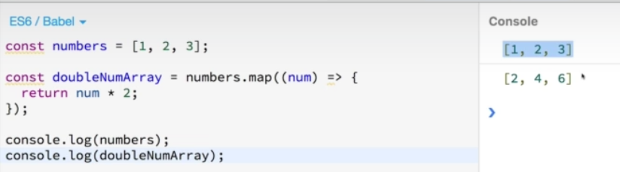
JavaScript Arrays

Slide 22
JavaScript Arrays Methods
toString()
Join()
Pop()
Push()
Shift()
unshift()
Delete
Concat() (for two arrays and three arrays)
Splice()
Slice()
Sort()
Reverse()

Slide 23
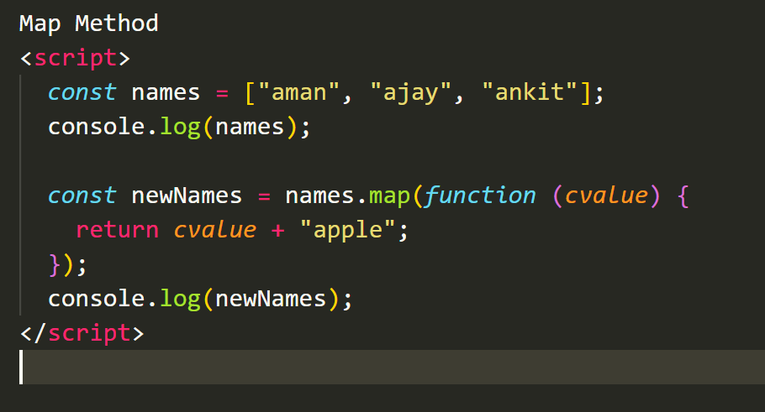
JavaScript Array Map Method

Slide 24
JavaScript Syntax
JavaScript can be implemented using JavaScript statements that are placed within the <script>... </script> HTML tags in a web page.
<script ...>
JavaScript code
</script>
JavaScript with type attribute:
<script type="text/javascript">
JavaScript code
</script>
Where to place JavaScript?
JavaScript can be placed in the <head> section of an HTML page.
JavaScript can be placed in the <body> section of an HTML page.
JavaScript can also be placed in external files and then linked to HTML Page.

Slide 25
JavaScript in the Head Section
<!DOCTYPE html>
<html>
<head>
<script>
function abc()
{
document.getElementById("ab").innerHTML = "LPU expects some better placements out of you";
}
</script>
</head>
<body>
<p id="ab">Welcome to LPU</p>
<input type="submit" onclick="abc()">
</body>
</html>

Slide 26
JavaScript in Body Section
<!DOCTYPE html>
<html>
<head>
</head>
<body>
<p id="abc">Welcome to LPU</p>
<input type="submit" onclick="abc()">
<script>
function abc()
{
document.getElementById("abc").innerHTML = "LPU expects some better placements out of you";
}
</script>
</body>
</html>
NB: It is a good idea to place scripts at the bottom of the <body> element. This can improve page load, because script compilation can slow down the display.

Slide 27
External JavaScript (b.js)
function abc()
{
document.getElementById("abc").innerHTML = "LPU expects some better placements out of you";
}
a.html
<!DOCTYPE html>
<html>
<head>
<script src=“b.js"></script>
</head>
<body>
<p id="abc">Welcome to LPU</p>
<input type="submit" onclick="abc()">
</body>
</html>
.

Slide 28
JavaScript Dialog Boxes
JavaScript supports three important types of dialog boxes. These dialog boxes can be used to raise and alert, or to get confirmation on any input or to have a kind of input from the users.
Alert Dialog Box
An alert dialog box is mostly used to give a warning message to the users. For example, if one input field requires to enter some text but the user does not provide any input, then as a part of validation, you can use an alert box to give a warning message.
Nonetheless, an alert box can still be used for friendlier messages. Alert box gives only one button "OK" to select and proceed.

Slide 29
Example
<!DOCTYPE html>
<html>
<head>
<script>
function abc()
{
window.alert("Welcome to LPU");
document.write("HTML Alert Dialog Box Example");
}
</script>
</head>
<body>
<input type="submit" onclick="abc()">
</body>
</html>

Slide 30
Confirmation Dialog Box
A confirmation dialog box is mostly used to take user's consent on any option. It displays a dialog box with two buttons: OK and Cancel.
If the user clicks on the OK button, the window method confirm() will return true. If the user clicks on the Cancel button, then confirm() returns false.

Slide 31
Example
<!DOCTYPE html>
<html>
<head>
<script>
function abc()
{
var retVal = confirm("Do you want to continue ?");
if( retVal == true ){
document.write ("User wants to continue!");
return true;
}
else{
document.write ("User does not want to continue!");
return false;
}
}
</script>
</head>
<body>
<input type="submit" onclick="abc()">
</body>
</html>

Slide 32
Prompt Dialog Box
The prompt dialog box is very useful when you want to pop-up a text box to get user input. Thus, it enables you to interact with the user. The user needs to fill in the field and then click OK.
This dialog box is displayed using a method called prompt() which takes two parameters:
a label which you want to display in the text box
a default string to display in the text box.
This dialog box has two buttons: OK and Cancel. If the user clicks the OK button, the window method prompt() will return the entered value from the text box. If the user clicks the Cancel button, the window method prompt()returns null.

Slide 33
Example
<!DOCTYPE html>
<html>
<head>
<script>
function abc()
{
var retVal = prompt("Enter your name : ", "your name here");
document.write("You have entered : " + retVal);
}
</script>
</head>
<body>
<input type="submit" onclick="abc()">
</body>
</html>

Slide 34
Events in JavaScript
JavaScript's interaction with HTML is handled through events that occur when the user or the browser manipulates a page.
When the page loads, it is called an event. When the user clicks a button, that click too is an event. Other examples include events like pressing any key, closing a window, resizing a window, etc.
onclick Event
This is the most frequently used event type which occurs when a user clicks the left button of his mouse. You can put your validation, warning etc., against this event type.

Slide 35
Example
<!DOCTYPE html>
<html>
<head>
<script type="text/javascript">
function abc() {
alert("Welcome to the School of CSE")
}
</script>
</head>
<body>
<form>
<input type="button" onclick="abc()" value="Test" />
</form>
</body>
</html>

Slide 36
onsubmit Event
onsubmit is an event that occurs when you try to submit a form. You can put your form validation against this event type.
Example
<!DOCTYPE html>
<html>
<head>
<script type="text/javascript">
function validate() {
alert("Validated");
}
</script>
</head>
<body>
<form method="POST" onsubmit="return validate()">
<input type="submit" value="Submit" >
</form>
</body>
</html>

Slide 37
onmouseover and onmouseout Events
These two event types will help you create nice effects with images or even with text as well. The onmouseover event triggers when you bring your mouse over any element and the onmouseout triggers when you move your mouse out from that element.
Example:
<!DOCTYPE html>
<html>
<head>
<script type="text/javascript">
function over() {
document.write ("Mouse Over");
}
</script>
</head>
<body>
<div onmouseover="over()">
Hello LPU
</div>
</body>
</html>

Slide 38
Example
<!DOCTYPE html>
<html>
<head>
<script type="text/javascript">
function out()
{
document.write ("Mouse Out");
}
</script>
</head>
<body>
<div onmouseout="out()">
Hello LPU
</div>
</body>
</html>

Slide 39
onkeypress Event
The onkeypress event occurs when the user presses a key (on the keyboard).
Example
<!DOCTYPE html>
<html>
<head>
<script type="text/javascript">
function abc() {
document.write ("Pressed");
}
</script>
</head>
<body>
<input type="text" onkeypress="abc()">
</body>
</html>

Slide 40
onload Event
The onload event occurs when an object has been loaded. onload is most often used within the <body> element to execute a script once a web page has completely loaded all content (including images, script files, CSS files, etc.).
Example
<!DOCTYPE html>
<html>
<head>
<script type="text/javascript">
function abc() {
document.write ("Example of Text on Page Loading");
}
</script>
</head>
<body onload="abc()">
</body>
</html>

Slide 41
JavaScript Form Validation
Form validation normally used to occur at the server, after the client had entered all the necessary data and then pressed the Submit button.
If the data entered by a client was incorrect or was simply missing, the server would have to send all the data back to the client and request that the form be resubmitted with correct information. This was really a lengthy process which used to put a lot of burden on the server.
JavaScript provides a way to validate form's data on the client's computer before sending it to the web server.

Slide 42
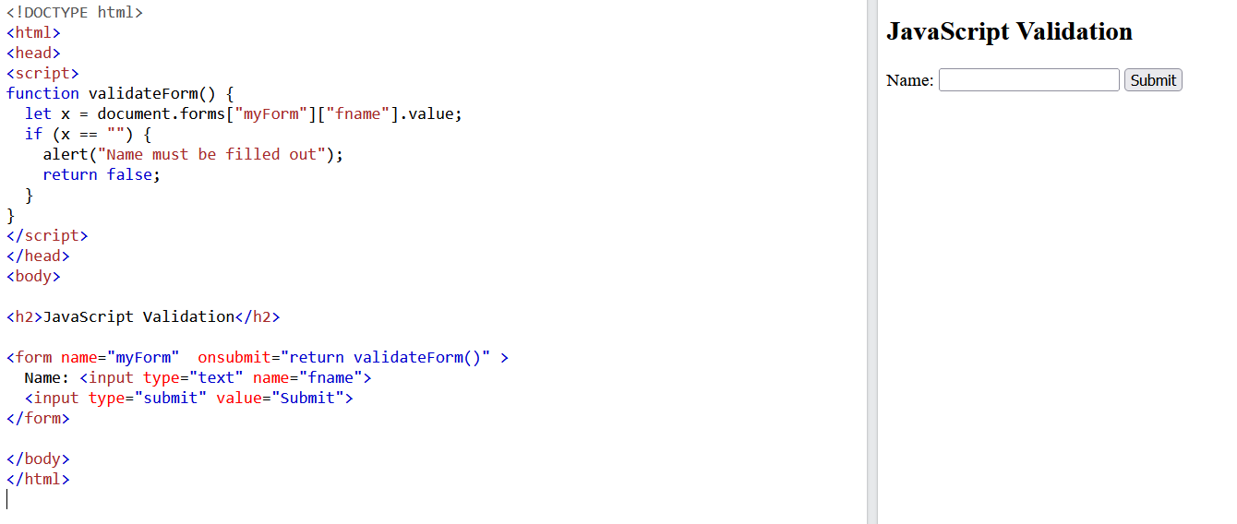

Slide 43
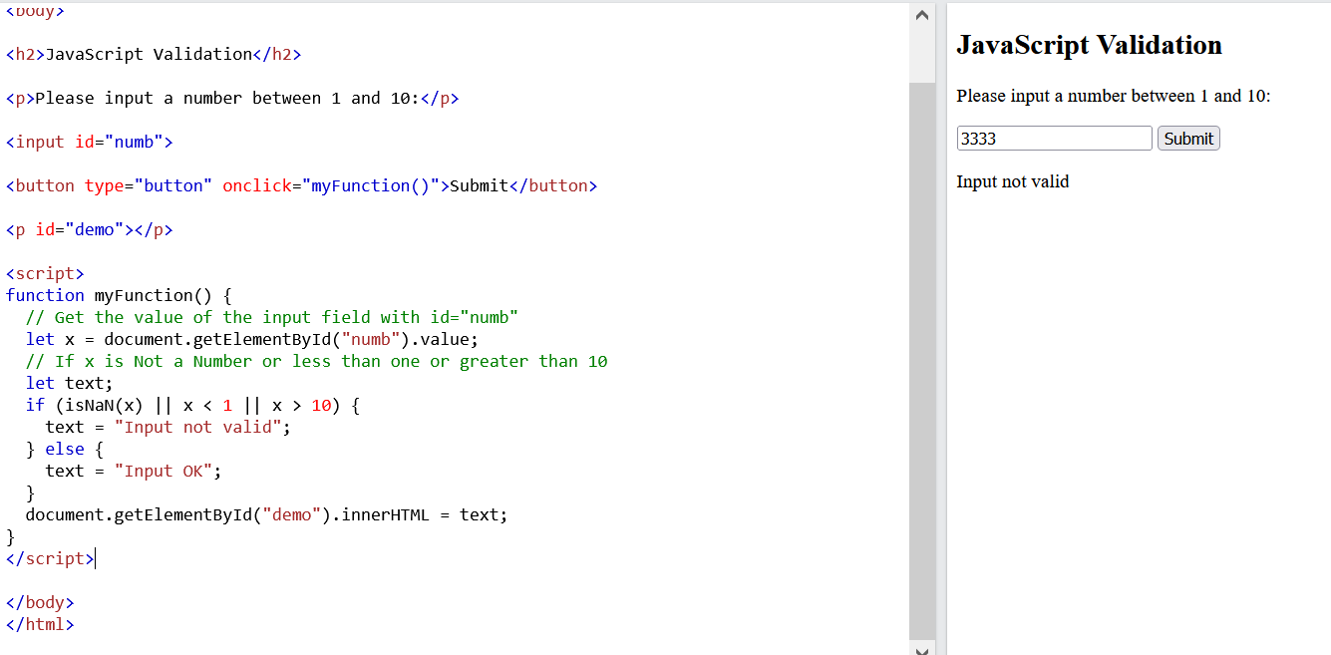

Slide 44
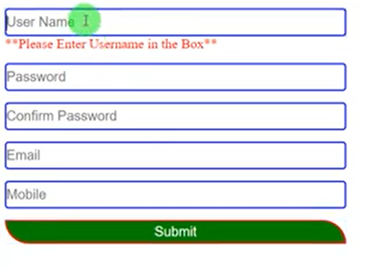
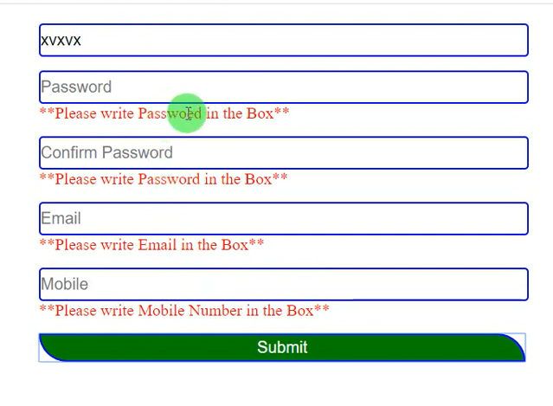

Slide 45
Example1: Matching Password and Confirm Password
<script type="text/javascript">
function CanSubmit() {
//alert("ok");
var pwd = document.forms[0].txtPassword.value
var cpwd = document.forms[0].txtConfirmPassword.value
if (pwd == cpwd)
return true;
else {
alert("Please make sure that Password and Confirm Password are Same");
return false;
}
}
</script>
<form action="" method="post" onsubmit ="return CanSubmit()">
Password: <input type="password" name="txtPassword" value="" /> <br />
ConfirmPassword: <input type="password" name="txtConfirmPassword" value="" /> <br />
<input type="submit" name="btnSubmit" value="Submit" />
</form>

Slide 46
Example 2: Providing alert before data will be deleted
function CanDelete()
{
return confirm("Are you Sure to delete your Data");
}
<input type="submit" name="btnDelete" value="Delete" onclick ="return CanDelete()" />

Slide 47
Example 3: Validate Textboxes for any data in arithmetic operations
function ValidateMathFunction()
{
var FN = document.forms[1].txtFN.value;
var SN = document.forms[1].txtSN.value;
if (FN == "" || SN == "") {
alert("Please ensure that data is inserted in both textboxes");
return false;
}
else
return true;
}
<form action="/" method="post" onsubmit="return ValidateMathFunction()">
Enter First Number <input type="text" name="txtFN" value="" /> <br />
Enter Second Number <input type="text" name="txtSN" value="" /><br />
<input type="submit" name="btnAdd" value="+" />
<input type="submit" name="btnSub" value="-" />
<input type="submit" name="btnMul" value="*" />
<input type="submit" name="btnDel" value="/" />
</form>

Slide 48
Example 4 Denominator cant be zero
function CheckDenominator() {
var SN = document.forms[1].txtSN.value;
if (SN == 0) {
alert("Denominator cant be zero");
return false;
}
else
return true;
}
<input type="submit" name="btnDel" value="/" onclick="return CheckDenominator()"/>

Slide 49
Example 5 Whether the values entered in textboxes are numbers or not?
function ValidateMathFunction()
{
var FN = document.forms[1].txtFN.value;
var SN = document.forms[1].txtSN.value;
if (FN == "" || SN == ""|| isNaN(FN)||isNaN(SN)) {
alert("Please ensure that valid data is inserted in both textboxes");
return false;
}
else
return true;
}

Slide 50
Example 6 Validating Email using Regular Expressions
<!DOCTYPE html>
<html>
<head>
<script type="text/javascript">
function validateEmail()
{
var emailTextBox = document.getElementById("txtEmail");
var email = emailTextBox.value;
var emailRegEx = /^(([^<>()[\]\\.,;:\s@\"]+(\.[^<>()[\]\\.,;:\s@\"]+)*)|(\".+\"))@((\[[0-9]{1,3}\.[0-9]{1,3}\.[0-9]{1,3}\.[0-9]{1,3}\])|(([a-zA-Z\-0-9]+\.)+[a-zA-Z]{2,}))$/;
emailTextBox.style.color = "white";

Slide 51
if (emailRegEx.test(email))
{
emailTextBox.style.backgroundColor = "green";
}
else
{
emailTextBox.style.backgroundColor = "red";
}
}
</script>
</head>
<body>
Email : <input type="text" id="txtEmail" onkeyup="validateEmail()" />
</body>
</html>

Slide 52
JavaScript Timing Events
In JavaScript a piece of code can be executed at specified time interval. For example, you can call a specific JavaScript function every 1 second. This concept in JavaScript is called timing events.
The global window object has the following 2 methods that allow us to execute a piece of JavaScript code at specified time intervals.
setInterval(func, delay) - Executes a specified function, repeatedly at specified time interval. This method has 2 parameters. The func parameter specifies the name of the function to execute. The delay parameter specifies the time in milliseconds to wait before calling the specified function.
setTimeout(func, delay) - Executes a specified function, after waiting a specified number of milliseconds. This method has 2 parameters. The func parameter specifies the name of the function to execute. The delay parameter specifies the time in milliseconds to wait before calling the specified function. The actual wait time (delay) may be longer.

Slide 53
The setInterval() method calls a function or evaluates an expression at specified intervals (in milliseconds). The setInterval() method will continue calling the function until clearInterval() is called, or the window is closed.
The following code displays current date and time in the div tag.
<!DOCTYPE html>
<html>
<head>
<script type="text/javascript">
function getCurrentDateTime()
{
document.getElementById("timeDiv").innerHTML = new Date();
}
</script>
</head>
<body>
<div id="timeDiv" ></div>
<input type="submit" onclick="getCurrentDateTime()">
</body>
</html>

Slide 54
At the moment the time is static.
To make the time on the page dynamic, modify the script as shown below. Notice that the time is now updated every second. In this example, we are using setInterval() method and calling getCurrentDateTime() function every 1000 milli-seconds.
<!DOCTYPE html>
<html>
<head>
<script type="text/javascript">
setInterval(getCurrentDateTime, 1000);
function getCurrentDateTime()
{
document.getElementById("timeDiv").innerHTML = new Date();
}
</script>
</head>
<body>
<div id="timeDiv" ></div>
<input type=“button” onclick=“setInterval”>
</body>
</html>

Slide 55
Starting and stopping the clock with button click : In this example, setInterval()method returns the intervalId which is then passed to clearInterval() method. When you click the "Start Clock" button the clock is updated with new time every second, and when you click "Stop Clock" button it stops the clock.
The clearInterval() method clears a timer set with the setInterval() method.
<!DOCTYPE html>
<html>
<head>
<script type="text/javascript">
var intervalId;
function startClock()
{
intervalId = setInterval(getCurrentDateTime, 1000);
}
function stopClock()
{
clearInterval(intervalId);
}

Slide 56
function getCurrentDateTime()
{
document.getElementById("timeDiv").innerHTML= new Date();
}
</script>
</head>
<body>
<div id="timeDiv" ></div> <br />
<input type="button" value="Start Clock" onclick="startClock()" />
<input type="button" value="Stop Clock" onclick="stopClock()" />
</body>
</html>

Slide 57

Now let's look at example of using setTimeout() and clearTimeout() functions. The syntax and usage of these 2 functions is very similar to setInterval() and clearInterval().
Countdown timer example :
When we click "Start Timer" button, the value 10 displayed in the textbox must start counting down. When click "Stop Timer" the countdown should stop. When you click "Start Timer" again, it should start counting down from where it stopped and when it reaches ZERO, it should display Done in the textbox and function should return.

Slide 58
<!DOCTYPE html>
<html>
<head>
<script type="text/javascript">
var intervalId;
function startTimer(controlId)
{
var control = document.getElementById(controlId);
var seconds = control.value;
seconds = seconds - 1;
if (seconds == 0)
{
control.value = "Done";
return;
}
else
{
control.value = seconds;
}

Slide 59
intervalId = setTimeout(function () { startTimer('txtBox'); }, 1000);
}
function stopTimer()
{
clearTimeout(intervalId);
}
</script>
</head>
<body>
<input type="text" value="10" id="txtBox" />
<br /><br />
<input type="button" value="Start Timer" onclick="startTimer('txtBox')" />
<input type="button" value="Stop Timer" onclick="stopTimer()" />
</body>
</html>

Slide 60
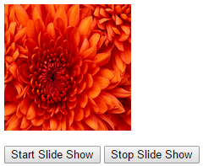
JavaScript Image Slideshow
The slideshow should be as shown in the image below.
When you click "Start Slide Show" button the image slideshow should start and when you click the "Stop Slide Show" button the image slideshow should stop.

Slide 61
<html>
<head>
<script type="text/javascript">
var intervalId;
function startImageSlideShow()
{
intervalId = setInterval(setImage, 500);
}
function stopImageSlideShow()
{
clearInterval(intervalId);
}
function setImage()
{
var imageSrc = document.getElementById("image").getAttribute("src");
var currentImageNumber = imageSrc.substring(imageSrc.lastIndexOf("/") + 1,imageSrc.lastIndexOf("/") + 2);

Slide 62
if (currentImageNumber == 6)
{
currentImageNumber = 0;
}
document.getElementById("image").setAttribute("src", "Images/" + (Number(currentImageNumber) + 1) + ".jpg");
}
</script>
</head>
<body>
<img id="image" src="Images/1.jpg" style="width: 500px; height: 150px" />
<br /> <br /> <br />
<input type="button" value="Start Slide Show" onclick="startImageSlideShow()" />
<input type="button" value="Stop Slide Show" onclick="stopImageSlideShow()" />
</body>
</html>

Slide 63
Recursive Function in JavaScript
Recursion is a programming concept that is applicable to all programming languages including JavaScript.
Recursive function is function that calls itself. When writing recursive functions there must be a definite break condition, otherwise we risk creating infinite loops.
Example : Computing the factorial of a number without recursion
<html>
<head>
<script>
function factorial(n)
{
if (n == 0 || n == 1)
{
return 1;
}

Slide 64
var result = n;
while (n > 1)
{
result = result * (n - 1)
n = n - 1;
}
return result;
}
function abc()
{
document.write(factorial(5));
}
</script>
<head>
<body>
<input type="submit" onclick="abc()">
</body>
</html>

Slide 65
Example : Computing the factorial of a number using a recursive function
<html>
<head>
<script>
function factorial(n)
{
if (n == 0 || n == 1)
{
return 1;
}
return n * factorial(n - 1);
}
function abc()
{
document.write(factorial(5));
}
</script>
<head>
<body>
<input type="submit" onclick="abc()">
</body>
</html>

Slide 66
Error handling in JavaScript
Use try/catch/finally to handle runtime errors in JavaScript. These runtime errors are called exceptions. An exception can occur for a variety of reasons. For example, referencing a variable or a method that is not defined can cause an exception.
The JavaScript statements that can possibly cause exceptions should be wrapped inside a try block. When a specific line in the try block causes an exception, the control is immediately transferred to the catch block skipping the rest of the code in the try block.
JavaScript try catch example :
<html>
<head>
<script>
function abc()
{
try
{
// Referencing a function that does not exist cause an exception
document.write(sayHello());
// Since the above line causes an exception, the following line will not be executed
document.write("This line will not be executed");
}

Slide 67
// When an exception occurs, the control is transferred to the catch block
catch (e)
{
document.write("Description = " + e.description + "<br/>");
document.write("Message = " + e.message + "<br/>");
document.write("Stack = " + e.stack + "<br/><br/>");
}
}
</script>
<head>
<body>
<input type="submit" onclick="abc()">
</body>
</html>
Please note : A try block should be followed by a catch block or finally block or both.
finally block is guaranteed to execute irrespective of whether there is an exception or not. It is generally used to clean and free resources that the script was holding onto during the program execution. For example, if your script in the try block has opened a file for processing, and if there is an exception, the finally block can be used to close the file.

Slide 68
Example with finally block
<html>
<head>
<script>
function abc()
{
try
{
// Referencing a function that does not exist cause an exception
document.write(sayHello());
// Since the above line causes an exception, the following line will not be executed
document.write("This line will not be executed");
}
// When an exception occurs, the control is transferred to the catch block
catch (e)
{
document.write("Description = " + e.description + "<br/>");
document.write("Message = " + e.message + "<br/>");
document.write("Stack = " + e.stack + "<br/><br/>");
}

Slide 69
finally
{
document.write("This line is guaranteed to execute");
}
}
</script>
<head>
<body>
<input type="submit" onclick="abc()">
</body>
</html>
Syntax errors and exceptions in JavaScript try/catch/finally block can catch exceptions but not syntax errors. Example : In the example, below we have a syntax error - missing the closing parentheses. The associated catch block will not catch the syntax errors.

Slide 70
<html>
<head>
<script>
function abc()
{
try
{
alert("Hello";
}
// When an exception occurs, the control is transferred to the catch block
catch (e)
{
document.write("JavaScript syntax errors cannot be caught in the catch block");
}
}
</script>
<head>
<body>
<input type="submit" onclick="abc()">
</body>
</html>

Slide 71
JavaScript throw statement : Use the throw statement to raise a customized exceptions.
JavaScript throw exception example :
<html>
<head>
<script>
function divide()
{
var numerator = Number(prompt("Enter numerator"));
var denominator = Number(prompt("Enter denominator"));
try
{
if (denominator == 0)
{
throw {
error: "Divide by zero error",
message: "Denominator cannot be zero"
};
}

Slide 72
else
{
alert("Result = " + (numerator / denominator));
}
}
catch (e)
{
document.write(e.error + "<br/>");
document.write(e.message + "<br/>");
}
}
</script>
<head>
<body>
<input type="submit" onclick="divide()">
</body>
</html>

Slide 73
Front End Development
Everything What we see on a website
buttons
links
animations
design
look
Content
Logos
Search bars
is a task of front end developer to convert clients requirement into the real and the website must look good in laptops, phones and tablets.
Three main things you must know for front end developments are HTML,CSS and JavaScript.

Slide 74
Front End Development
CSS Frameworks, Libraries, and Preprocessors
Bootstrap
Tailwind CSS
Bulma
Materialize
Semantic UI
JavaScript libraries and frameworks
React
Angular
Vue
Testing and Debugging skills
Version control (Learn Git)
Problem Solving

Slide 75
Best Practices for Optimizing front end Performance
Minify Resources
Reduce the Number of Server Calls
Remove Unnecessary Custom Fonts
Compress Files
Optimize the Images
Apply Lazy Loading
Caching
Enable Prefetching
Use a Content Delivery Network
https://blog.bitsrc.io/9-best-practices-for-optimizing-frontend-loading-time-763211621061

Slide 76
SPA(Single Page Application) VS MPA(Multi Page Application)
If you want your web app runs without any interference, then it must be supported by the right technology to get high performance and speed.
You can develop your web apps by two ways: SPA(single-page applications) and MPA(multi-page applications)
A single-page application is a modern approach used by Google, Facebook, Twitter, etc to app development. It works inside a browser and does not require page reloading during use.
Multiple-page application is classical approach to app development. The multi-page design pattern requires a page reload every time the content changes. It’s a preferred option for large companies with extensive product portfolios, such as e-commerce businesses.
https://blog.bitsrc.io/9-best-practices-for-optimizing-frontend-loading-time-763211621061

Slide 77
SPA(Single Page Application) VS MPA(Multi Page Application)
Speed is fast in SPA than MPA.
Coupling: SPA is strongly decoupled, meaning that the front-end and back-end are separate. SPA applications use APIs developed by server-side developers to read and display data. In MPA’s, the front-end and back-end are interdependent. All coding is usually housed under one project.
Search Engine Optimization MPA is more SEO friendly than SPA.
User Experience
Security: SPA is more secure due to its size.
Development process
JavaScript dependency
https://asperbrothers.com/blog/spa-vs-mpa/

Slide 78
THANKS

